Slide 1
Analyzing the Demographic Diversity of Volunteer Participation in AmeriCorps
DATS 6101, Group 8
Aidan Carlisle | Sayan Patra | Rachel Thomas | Anusha Umashankar

Slide 2

What is AmeriCorps?
US Federal agency that “brings people together to tacke the country’s most pressing challenges through national service and volunteering.”
AmeriCorps
AmeriCorps NCCC
AmeriCorps State and National
Public Health AmeriCorps
AmeriCorps VISTA
AmeriCorps Seniors
Foster Granparent Program
RSVP
Senior Companion Program
Senior Demonstration Program

Slide 3
Where is the data from?
Collected and published by AmeriCorps
Provides comparisons of demographic group prevalence in AmeriCorps Member/Volunteers populations to the greater U.S. population
The source dataset consists of about 26000 observations over 17 attributes

Slide 4
Proposed SMART Questions
Which program offices are most effective in engaging a diverse range of participants?
How does the representation of different demographic groups compare to their proportions in the general population?
Which groups are overrepresented or underrepresented in AmeriCorps?
How do participation rates compare between different programs within the same service region?
What is the racial composition of the volunteers?
Are some racial groups more engaged in volunteer activities within specific states?

Slide 5
Important note on MSYs
For member data, member service years [MSYs] (i.e., the number of days or hours members are required to serve over the course of their term to fulfill their service requirements) are summed and used in place of observed member counts to account for potential differences in service time allotments assigned to different demographic groups.

Slide 6
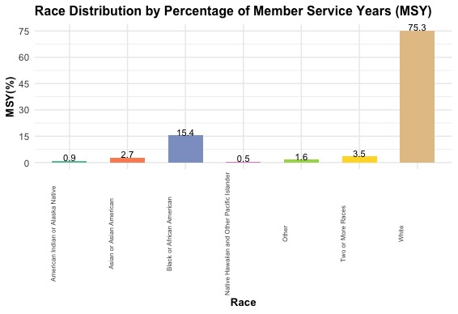
What is the racial composition of the volunteers?

Slide 7
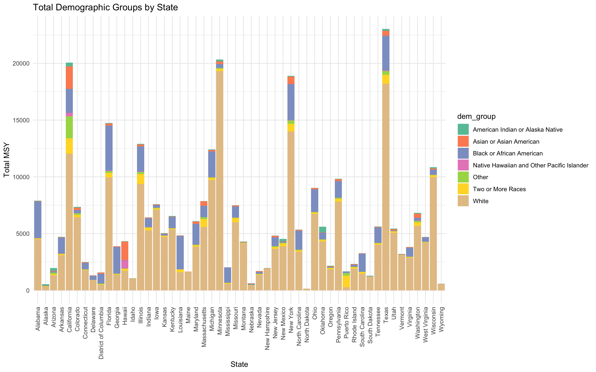
Are some racial groups more engaged in volunteer activities within specific states?

Slide 8
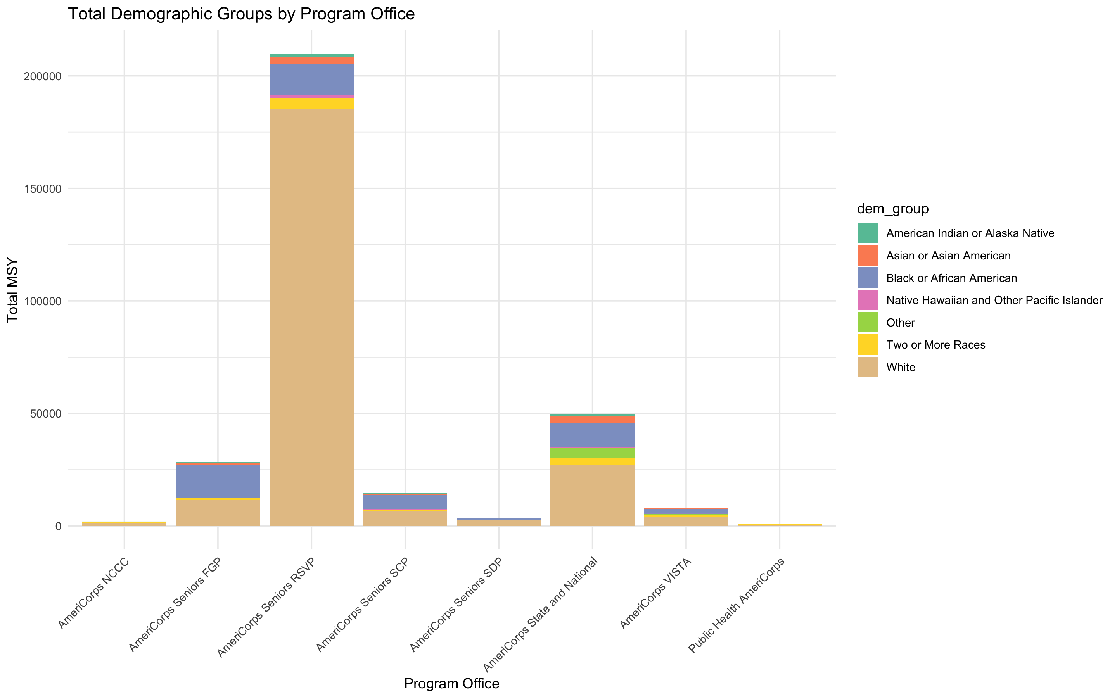
Which program offices are most effective in engaging a diverse range of participants?

Slide 9
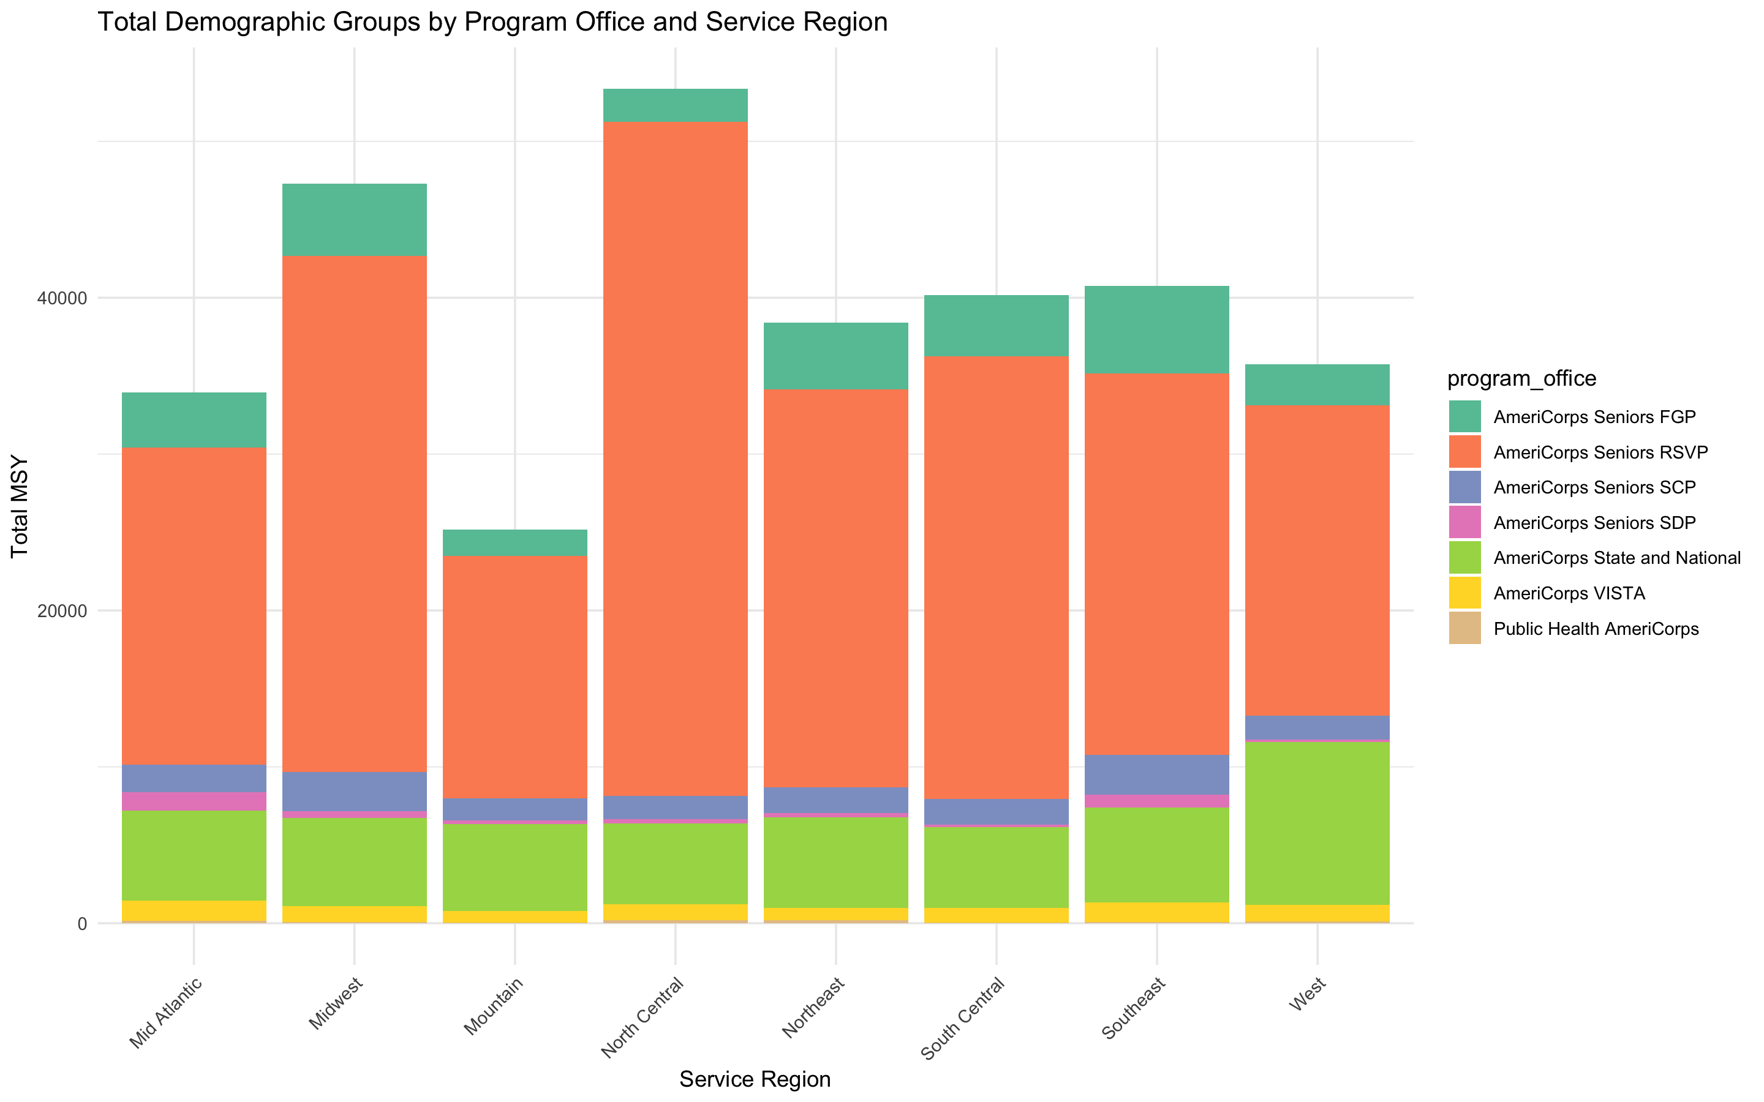
How do participation rates compare between different programs within the same service region?

Slide 10
The questions we couldn’t answer
How does the representation of different demographic groups compare to their proportions in the general population?
Which groups are overrepresented or underrepresented in AmeriCorps?

Slide 11
Conclusion
AmeriCorps consists of
AmeriCorps aims for its volunteers to be representative both of the nation and of the communities it serves
The data seems to indicate it is not quite reflective

